Slide 1

Kavish Ghag Hritik Pandey
Zomato
EDA Analysis
March 12, 2025

Slide 2
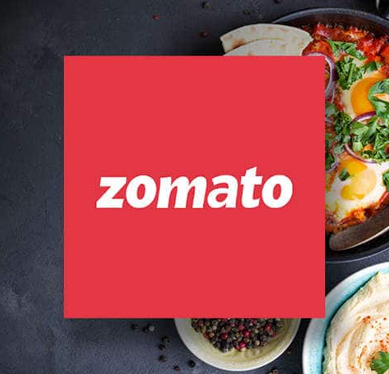

Agenda
Introduction
Data Collection
EDA Analysis
Closing

Slide 3
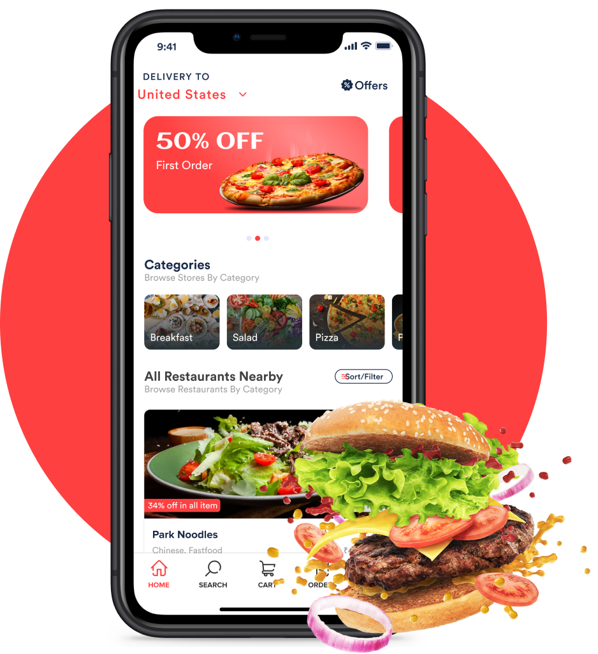

Introduction
Exploratory Data Analysis (EDA) serves as the foundation for uncovering hidden patterns, validating assumptions, and extracting actionable insights from the Zomato dataset. In this analysis, we dive into a rich repository of restaurant data—including attributes like restaurant name, location, cuisines, average cost for two, ratings, and reviews—to understand consumer preferences and market trends in the food industry.

Slide 4
Data Gathering
Tools and Techniques

Slide 5


Data Gathering
The Kaggle dataset gathering of Zomato is a comprehensive collection of restaurant data that serves as a robust foundation for exploratory data analysis. It aggregates detailed information such as restaurant IDs, names, locations, cuisines, average cost for two, customer ratings, and reviews. This rich dataset allows data enthusiasts and professionals to uncover hidden patterns and correlations—such as the relationship between pricing and ratings or the popularity of various cuisines across different regions. By leveraging this well-structured data, analysts can generate insights that inform strategic decision-making in the competitive food and hospitality industry, as well as build predictive models for market trends.

Slide 6
Tools & Techniques
Python is a versatile, high-level programming language known for its simplicity and readability, making it a popular choice for data analysis, machine learning, web development, and automation. Its extensive libraries, such as Pandas, NumPy, and Scikit-learn, simplify complex data manipulation and analysis tasks. Google Colab (short for Colaboratory) is a cloud-based platform that allows users to write and execute Python code in a Jupyter Notebook-like environment. It supports free access to powerful GPUs and TPUs, making it ideal for machine learning and deep learning projects. Colab also integrates seamlessly with Google Drive, enabling easy data storage and collaboration, which makes it an accessible and powerful tool for data scientists and developers.

Slide 7
EDA Analysis
Zomato Market Analysis

Slide 8
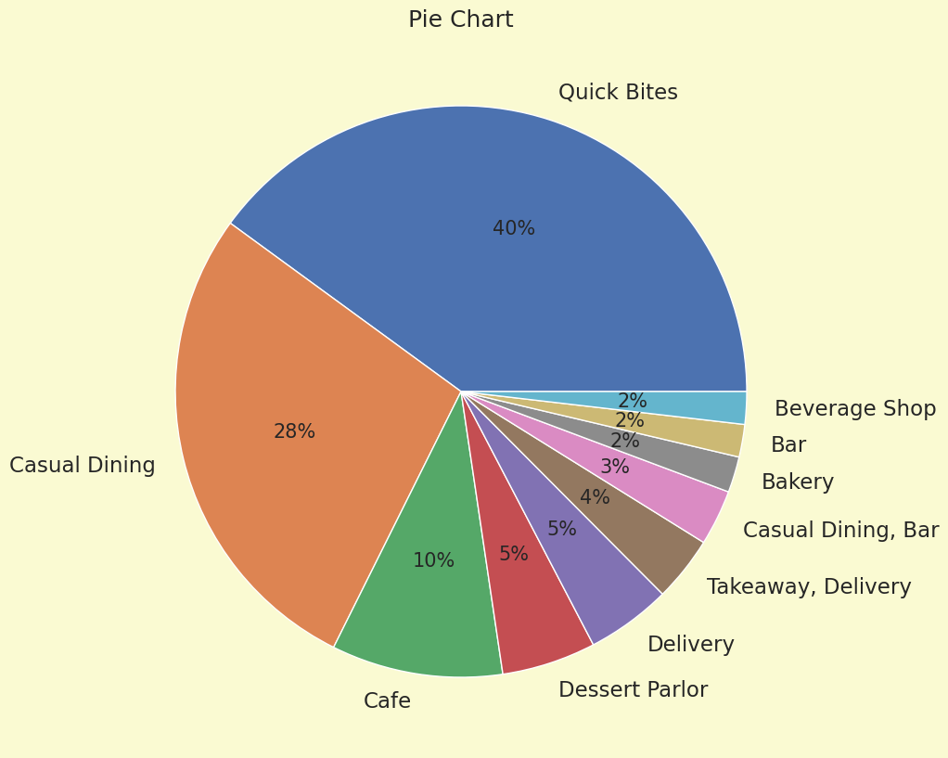
EDA Anaysis

Slide 9

Conclusion
In conclusion, the Zomato EDA project provides valuable insights into customer preferences, restaurant performance, and market trends in the food industry. Through thorough data cleaning, visualization, and analysis, key patterns such as the relationship between ratings and cost, the popularity of different cuisines, and the impact of services like online ordering and table booking have been identified. The project highlights the importance of understanding customer behavior and operational dynamics to enhance business strategies and customer satisfaction. These insights can serve as a foundation for predictive modeling and decision-making, helping restaurants optimize their offerings and improve overall customer experience.

